Slide 1
From Analog to digital media
Dharanipathi Rathna Kumar

Slide 2
Mechanical
The end of the 19th century saw the arrival of electronic instruments and recorded sound
Before Electronics technology existed music was only available as a live performance and in printed form
The development of the upright piano in the early 1800’s led to it being a fixture in US middle-class home by the end of the century

Slide 3
Electricity
The development of the Electricity industry was the spur for the development of new technologies
The spread of electrification from the cities, to towns, to rural areas, provided a major stimulus for new products that would transform peoples’ lives
One aspect was the individuation of activities where people now had an extended area of usable space after nightfall

Slide 4
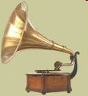
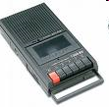
Arrival of Electronics
Two major technologies dominated recorded music for almost 100 years
The phonograph
The Tape player

Slide 5
The Phonograph
The phonograph, or record player is over 100 years old
The first working phonograph was invented by Tomas Edison in 1877
It was a tinfoil sheet wrapped around a grooved cylinder. The sound was made by indentations in the foil by a stylus

Slide 6
The Gramaphone Disc
By 1890 the Gramaphone disc record had been created and the first mass production of records was attempted
A standard rotation speed of 78 RPM was eventually agreed upon
The discs were usually 10’’ in diameter and could hold 3 minutes of music
They were made from a compound that included 25% Shellac. They were brittle and could be easily broken

Slide 7
The Gramaphone
Still, even with further advances one original recording could only produce 90-150 copies meaning that the recording artist would have to make a number of recordings of their song to sell a hit!

Slide 8
How does a record player work?
A record player consists of three main parts: the turntable, tonearm and stylus.
The turntable was originally a cylinder but this became a flat rotating platter driven by a motor

Slide 9
How does a record player work?
The tonearm is fixed to the turntable and extends across the surface of the record.
On the end of the tonearm is the stylus, the part that actually makes contact with the record and reproduces the sound recorded there.
The earliest styluses had crystal tips. These were replaced by ones made from ceramic, that were eventually superseded by ones with a diamond tip

Slide 10
How does a record work?
The principle is that as the record is rotated tiny indentations in the walls of the groove move the stylus.
Movements of the stylus create a fluctuation in the electromagnetic field that induces an electric current in a coil attached to it.

Slide 11
How does a record work?
This current is sent to the amplifier which reproduces the original sound.
The creation of a record is much like the playback process, except in reverse. Instead of passing a stylus over the groove to recreate a recording, an album cutter connected to an input source passes over a blank disc and etches the grooves into place. From this master copy, a metal stamp is made and copies are mass-produced.

Slide 12
Microscopic Images
78 rpm
33 1/3 rpm

Slide 13
Groove Profile
78 rpm
(round)
33 1/3 rpm
(triangular)

Slide 14
Post World War II
The Record industry declined during the Great Depression but after World War II sales grew again
By 1948 the Columbia company had perfected the 12" Long Playing Vinyl disc. Spinning at 33 and 1/3 rpm the new format could play up to 25 minutes per side. This new record medium also had a much lower level of surface noise than its older shellac cousin

Slide 15
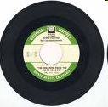
The 45
However, Columbia's big rival, RCA Victor then produced the seven inch 45 rpm vinyl disc. These could hold as much sound as the 78 rpm discs they replaced, but were much smaller and more attractive.

Slide 16
Playback Equipment
In the 1950s, the term high fidelity began to be used by audio manufacturers as a marketing term to describe records and equipment which were intended to provide faithful sound reproduction.
While some consumers simply interpreted high fidelity as fancy and expensive equipment, many found the difference in quality between "hi-fi" and the then standard AM radios and 78 RPM records readily apparent and deliberately bought 33 LPs

Slide 17
Hi Fi and Stereo
In the late 1950s and early 1960s, the development of the Westrex single-groove stereophonic record cutting lathe led to the next improvement, records were now played on a stereo.
However, for audiophiles high fidelity continued to refer to the goal of highly-accurate sound reproduction and its associated technology

Slide 18
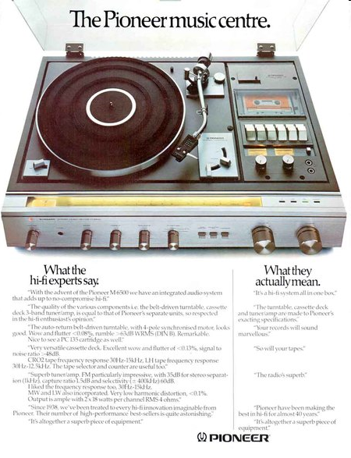
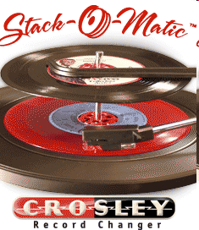
Playback - Hi Fi
The quality of playback improved a lot during the 1970’s with many advances in the quality of the playback equipment. The integrated music centre came into being.

Slide 19

Vinyl records problems
It was difficult to keep records scratch free which produced popping noises
Another phenomenon was groove lock which caused sections to repeat over and over again
Records could warp if left close to a heat source making them unplayable
Record crackling
Record groove-lock

Slide 20
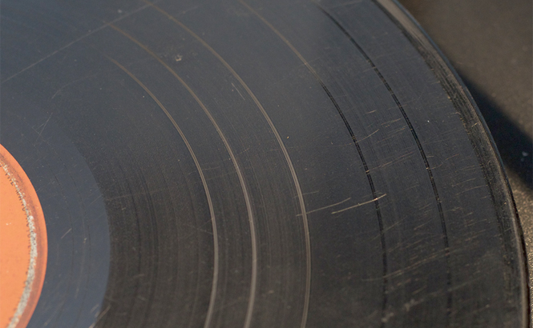
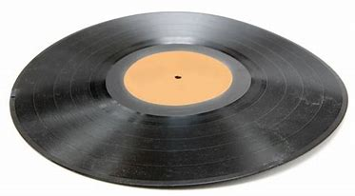
Vinyl issues
Scratched record
Warped record

Slide 21
Tape
Magnetic tape for recording sound was invented by Fritz Pfleumer in 1928 in Germany
The reel-to-reel format was used for the earliest tape recorders

Slide 22
Post World War II
It was not until after World War II that commercial systems were developed in the US
Phillips introduced the compact cassette in 1963 which replaced the use of reel-to-reel recorders for consumer use
The narrow tracks and slow recording speed did impact the fidelity

Slide 23
Post World War II
However, in recording studios the reel-to-reel recorders remained popular as it was felt that they had a great sound

Slide 24
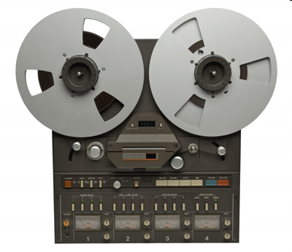

Tape

Slide 25
Four Types of Tape
The original ferric-oxide tape. It is very rarely seen these days.
The standard ferric-oxide tape, also referred to as "normal bias."
The "chrome" or CrO2 tape. The ferric-oxide particles are mixed with chromium dioxide.
The "metal" tape. Metallic particles rather than metal-oxide particles are used in the tape.

Slide 26
Types of Tape
Sound quality improves as you go from one type to the next, with metal tapes having the best sound quality.

Slide 27
Cassette
The sound quality of early cassette tapes was poor but improved during the 1970’s
Early players were designed for dictation rather than music
The 1980’s saw a significant rise in tape use with the introduction of portable music players such as the walkman. Cassette sales outstripped those of LPs
Terms such as fast forward have become part of everyday language

Slide 28
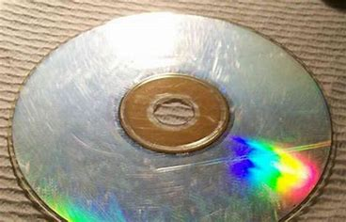
Storing Digital Audio
Digital audio can be stored on CDs, hard drives, solid-state memory
Completely flexible as the file is the same, no matter which format is used
Not without its problems – CDs get scratched, Hard drives can fail; memory sticks can be easily lost

Slide 29
Soundcards
External Soundcards are available from most music equipment retailers
Well-known manufacturers include m-audio, focusrite, RME
They vary in cost from around €5 up to €1000 or more depending on the specifications
They will usually be connected to your computer using USB technology
Key selling features are the sample rates it supports, the number of bits in the sampled signal, the frequency response of the unit, the number of inputs and outputs it supports

Slide 30
The sound card from Analog Input to Digital Output
Anti-aliasing filter
Analog to Digital Sampling
Quantization
Digital values available in the computer
Analog Input
Sampling Rate determines the anti-aliasing filter cutoff
Set the Sampling Rate
Set the Number of bits

Slide 31
The sound card from the Digital values to the Analog Output
Digital to Analog Reconstruction
Pre-Amplification
Analog signal to loudspeaker
Digital values
input the Sampling Rate
Gain value

Slide 32
Recording
Choose the sound card and decide on the sample rate and number of bits
Be careful with input levels to the soundcard while recording, don’t let the input be too strong or clipping of the top of the signal waveform will occur resulting in distortion
Any post-processing can be done with Software tools

Slide 33
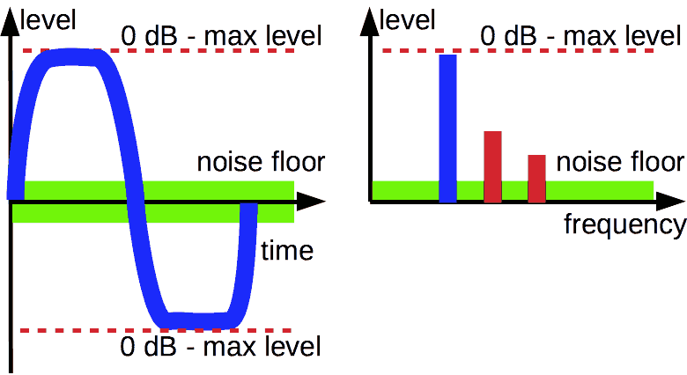
With Overloading – Audio Clipping results
Signal is clipped at the maximal allowable level
When recording take care not to overload the input
Distortion harmonics
See https://samplerateconverter.com/educational/dynamic-range

Slide 34
Clipping
Basically it is an amplitude distortion as the top of the signal is altered by being cut-off
Changing the shape of a waveform will alter its timbre
This changes the perceptual quality of the recording

Slide 35
Hard and Soft Clipping in the Recording context
Hard Clipping is associated with digital systems and is thought to introduce a harsh, unpleasant quality to the digital recording
Soft clipping in the form of saturation is associated with analog recording equipment

Slide 36
Hard Clipping Example

Slide 37
Analog Saturation
This was the case with Analog tape and was felt to impart a warm quality
Saturation rounds the corners of the waveform rather than cutting them abruptly

Slide 38
Soft Clipping

Slide 39
Hard and Soft Clipping in the Effects context
Clipping is also used in distortion effects, such as for the guitar
You can have strong distortion or a warmer overdrive
Tubes are reputed to have a great distortion that means that they have retained their popularity with guitarists

Slide 40
Sampling rate
Guided by the Shannon sampling theorem and the Nyquist rate
Expressed in Hertz and typically values of 44.1kHz, 48kHz, 96kHz, 192kHz
Is a bigger sampling rate better? This is a tricky question

Slide 41
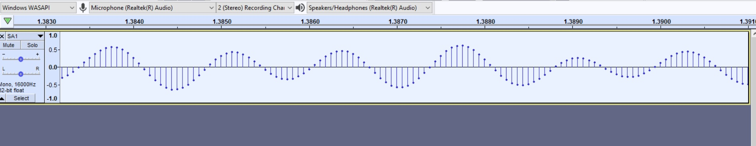
Digital Audio Samples appearance
Illustration taken from Audacity –each value in the graph is a sample of the original analog wave

Slide 42
Sample Rate
This is the number of samples of audio signal taken every second by the analog to digital converter in the sound card device. 44100Hz is the same rate for CD-quality audio but higher rates are more commonplace now
More samples means more data!
Why 44100Hz? Two reasons, one is technical and the other is to do with psychoacoustics.
Technical Reason: Early digital audio recorders were made from video machines - In 60 Hz video, there are 35 blanked lines, leaving 490 lines per frame, or 245 lines per field for samples. If three samples are stored per line, the sampling rate becomes 60 × 245 × 3 = 44.1 kHz.…

Slide 43
Shannon’s Theorem
When choosing the value for the sampling rate there are theorems that helps to guide our choice
One is called Shannon’s sampling theorem after the US mathematician Claude Shannon

Slide 44
Shannon’s Sampling Theorem
Any signal can be reconstructed exactly from its samples if the highest frequency present in the signal (f_{max}) is no greater than half the sampling frequency (F_{s}),
This means for a sinewave there should be at least two samples for every period of the waveform
The value F_{s}/2 is also called the Nyquist frequency
An anti-aliasing filter is always used to suppress the energy at frequencies above the Nyquist frequency from the analog signal being recorded. Even if we cannot hear what might exist at these supersonic frequencies, it will create problems if they are not eliminated before the sampling process.

Slide 45
Shannon Sampling illustration
In the top panel is the sampling of a waveform following the Shannon theorem exactly
The one in the middle panel is undersampled
In the bottom panel it is oversampled, meaning that more samples then required by the Nyquist rate are obtained

Slide 46
Sampling at CD quality 44100Hz
The sample rate of 44.1 kHz allows for audio signals with maximum frequencies up to 22.05 kHz to be recorded according to the Shannon sampling theorem.
Psychoacoustic Reason: Humans can hear frequencies between 20 Hz and 20 kHz. Actually, most people lose their ability to hear high frequencies as they get older and can only hear frequencies no greater than 15 kHz–18 kHz. The Nyquist rate of 22050Hz is greater than 20kHz so it means that perfect reconstruction of the audio from the samples is possible.
Also, by placing the Nyquist frequency greater than our hearing range, we can use anti-aliasing filters with less strict design requirements to eliminate the frequency energy greater than 20kHz in the signal

Slide 47
Higher Sample rates
48 kHz is another common sample rate. 48 kHz is often used in “professional audio” contexts. For instance, it’s the standard sample rate in audio for video. This sample rate moves the half the sampling rate value to 24 kHz
Some engineers choose to work in even higher sample rates, which tend to be multiples of either 44.1 kHz or 48 kHz. Sample rates of 88.2 kHz, 96 kHz, 176.4 kHz, and 192 kHz are available, meaning supersonic frequencies can be digitized.
Remember more samples=more data = more storage space required = more data to process!

Slide 48
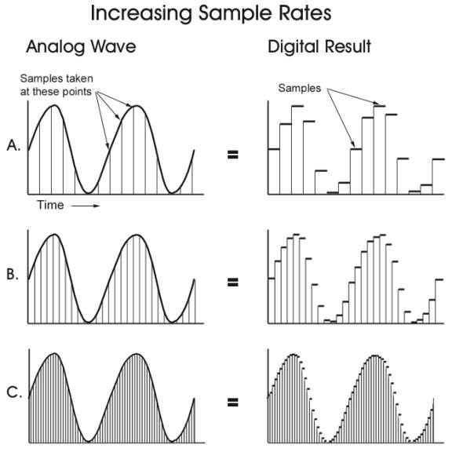
Effect of Increasing the sampling rate
More samples means more data!

Slide 49
Lower Sample rates
Low sampling rates such as 8kHz are often used for speech signals. Here, the emphasis is not on the audio quality but simply the data requirements.
At 8kHz the message in the audio can be easily understood but the high frequency information is gone so the quality is lower. But with a lower sampling rate there are less samples to store or send so the data requirements are lower.

Slide 50
Summary
High sample rate means more high frequency information is kept and thus a better audio quality
High sample rates mean more data so more storage requirements

Slide 51
DAWs (to name but a few)
Ableton Live
Logic pro
Cubase
Pro tools
Sonar
Studio one
Reaper
FL studio
Garageband
LMMS
Reason

Slide 52
Digital Audio Editing and Repair
Adobe audition
Audacity
Izotope RX10

Slide 53
Analysis tools
Sonic Visualizer (https://www.sonicvisualiser.org/)
Tony (https://www.sonicvisualiser.org/tony/)
Spear (https://www.klingbeil.com/spear/)

Slide 54
Languages/tools for sound synthesis
Csound
Pure Data
SuperCollider
Faust
ChucK
Max/MSP

Slide 55
Source Separation
AudiosourceRe https://www.audiosourcere.com/
RipX https://hitnmix.com/
LaLaLaAI https://www.lalal.ai/
Riffstation

Slide 56
Speech Recognition
Alibaba Cloud Intelligent Speech Interaction
Nuance dragon https://www.nuance.com/dragon.html
https://www.spiceworks.com/tech/artificial-intelligence/articles/speech-recognition-software/
Voice biometrics https://www.aculab.com/biometric-technologies/

Slide 57
Speech Synthesis
https://www.voicegain.ai/
https://murf.ai/
https://www.readspeaker.com/
Sonatic https://www.sonantic.io/
JAWS https://www.freedomscientific.com/products/software/jaws/

Slide 58
Music Data Recognition and Analysis
Shazam https://www.shazam.com/home
ScoreCloud automated notation software
Music21 Computer Aided musicology

Slide 59
Singing Synthesis
Vocaloid https://www.vocaloid.com/en/
Synth V https://dreamtonics.com/en/synthesizerv/

